Slide 1

Mining of Massive Datasets: Course Introduction
Note to other teachers and users of these slides: We would be delighted if you found this our material useful in giving your own lectures. Feel free to use these slides verbatim, or to modify them to fit your own needs. If you make use of a significant portion of these slides in your own lecture, please include this message, or a link to our web site: http://www.mmds.org
Mining of Massive Datasets
Jure Leskovec, Anand Rajaraman, Jeff Ullman Stanford University
http://www.mmds.org

Slide 2
What is Data Mining? Knowledge discovery from data

Slide 3
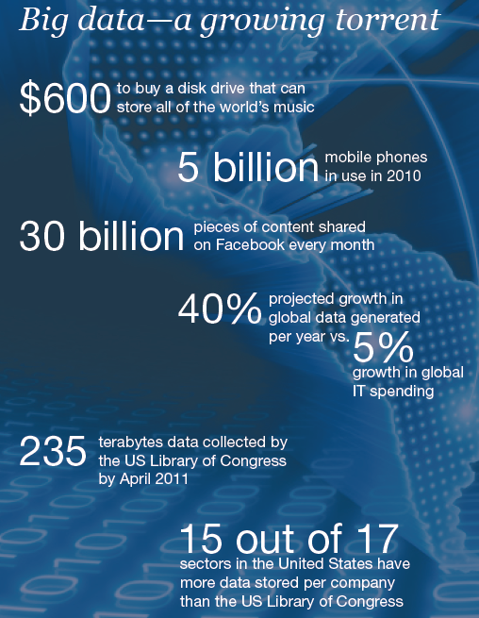
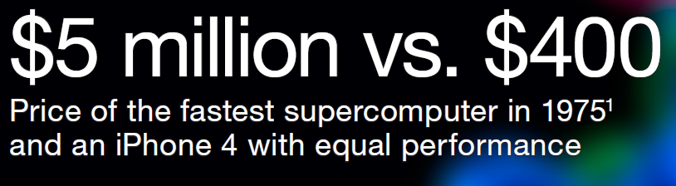

Slide 4

Data contains value and knowledge

Slide 5
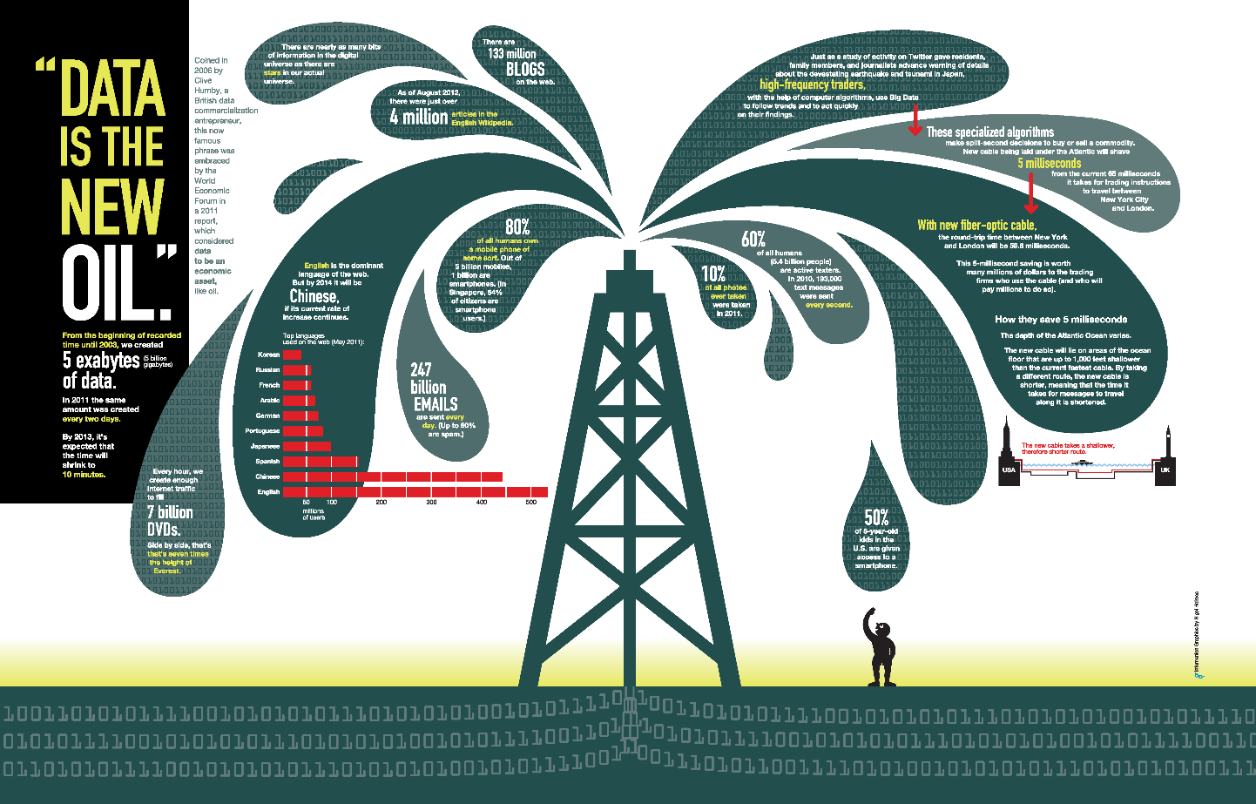
“Data is the New Oil” – World Economic Forum
Data is just like crude oil.
It is valuable, but if unrefined it cannot really be used.
It has to be changed into gas, plastic, chemicals, etc. to create a valuable entity that drives profitable activity; so must data be broken down, analyzed for it to have value.

Slide 6
Data Mining
But to extract the knowledge data needs to be
Stored
Managed
And ANALYZED
Data Mining ≈ Big Data ≈ Predictive Analytics ≈ Data Science
Notes:
Around 2010, people instead started to speak of “big data.
Today, the popular term is “data science.” However, during all this time, the concept remained the same:
use the most powerful hardware, the most powerful programming systems, and
the most efficient algorithms to solve problems in science, commerce, healthcare,
government, the humanities, and many other fields of human endeavor.

Slide 7
What is Data Mining?
Given lots of data
Discover patterns and models that are:
Valid: hold on new data with some certainty
Useful: should be possible to act on the item
Unexpected: non-obvious to the system
Understandable: humans should be able to interpret the pattern
Notes:
To many, data mining is the process of creating a model from data, often by
the process of machine learning.
However, more generally, the objective of data mining
is an algorithm.
: Consider the problem of detecting emails that are phishing
attacks. The most common approach is to build a model of phishing emails,
perhaps by examining emails that people have recently reported as phishing
attacks and looking for the words or phrases that appear unusually often in
those emails, such as “Nigerian prince” or “verify account.” The model could
be weights on words, with positive weights for words that appear frequently in
phishing emails and negative weights for words that do not. Then the algorithm
to detect phishing emails is simple. Apply the model to each email, that is, sum
the weights of the words in that email, and say the email is phishing if and only
if the sum is positive.
Yet in many important applications, the hard part is creating the
model, and once the model is available, the algorithm to use the model is
straightforward.

Slide 8
Data Mining Tasks
Descriptive methods
Find human-interpretable patterns that describe the data
Example: Clustering
Predictive methods
Use some variables to predict unknown or future values of other variables
Example: Recommender systems

Slide 9
Computational Approaches to Data Mining
Descriptive, to answer the question: What’s happening?
Diagnostic, to answer the question: Why’s happening?
Predictive, to answer the question: What will happen?
Prescriptive, to answer the question: What actions should we take?

Slide 10
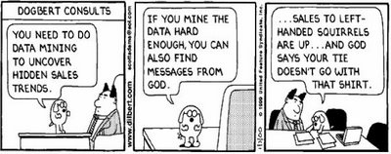
Meaningfulness of Analytic Answers
A risk with “Data mining” is that an analyst can “discover” patterns that are meaningless
Statisticians call it Bonferroni’s principle:
Roughly, if you look in more places for interesting patterns than your amount of data will support, you are bound to find crap
Notes:
Bonferroni’s Principle states that when searching large datasets, some unusual patterns will appear purely by chance, even if there is no real meaning behind them. If the number of random occurrences is much higher than the number of actual events you are trying to find, most of the detected results will be false positives. Therefore, to identify real events reliably, you should look for patterns that are very rare and unlikely to occur in random data.

Slide 11
Meaningfulness of Analytic Answers
Example:
We want to find (unrelated) people who at least twice have stayed at the same hotel on the same day
10⁹ people being tracked
1,000 days
Each person stays in a hotel 1% of time (1 day out of 100)
Hotels hold 100 people (so 10⁵ hotels)
If everyone behaves randomly (i.e., no terrorists) will the data mining detect anything suspicious?
Expected number of “suspicious” pairs of people:
250,000
… too many combinations to check – we need to have some additional evidence to find “suspicious” pairs of people in some more efficient way
Notes:
To find evil-doers in this data, we shall look for people who, on two different
days, were both at the same hotel.

Slide 12
What matters when dealing with data?
Challenges
Usage
Quality
Context
Streaming
Scalability
Collect
Prepare
Text
Data
Modalities
Ontologies
Networks
Signals
Represent
Structured
Multimedia
Model
Reason
Visualize
Data Operators
Notes:
Ontologies are semantic data models that define concepts and relationships, enabling machines to understand and reason about the meaning of data rather than just storing raw values.

Slide 13
Data Mining: Cultures
Data mining overlaps with:
Databases: Large-scale data, simple queries
Machine learning: Small data, Complex models
CS Theory: (Randomized) Algorithms
Different cultures:
To a DB person, data mining is an extreme form of analytic processing – queries that examine large amounts of data
Result is the query answer
To a ML person, data-mining is the inference of models
Result is the parameters of the model
CS Theory
Machine Learning
Data Mining
Database systems

Slide 14
Data Mining
Data Mining overlaps with machine learning, statistics, artificial intelligence, databases but more stress on
Scalability (big data)
Algorithms
Computing architectures
Automation for handling large data
Statistics
Machine
Learning
Data Mining
Database systems

Slide 15
What will we learn?
We will learn to mine different types of data:
Data is high dimensional
Data is a graph
Data is infinite/never-ending
Data is labeled
We will learn to use different models of computation:
MapReduce
Streams and online algorithms
Single machine in-memory

Slide 16
What will we learn?
We will learn to solve real-world problems:
Recommender systems
Market Basket Analysis
Spam detection
Duplicate document detection
We will learn various “tools”:
Linear algebra (SVD, Rec. Sys., Communities)
Optimization (stochastic gradient descent)
Dynamic programming (frequent itemsets)
Hashing (LSH, Bloom filters)

Slide 17
How It All Fits Together
High dim. data
Locality sensitive hashing
Clustering
Graph data
PageRank, SimRank
Community Detection
Infinite data
Filtering data streams
Web advertising
Dimensionality reduction
Spam Detection
Queries on streams
Machine learning
SVM
Decision Trees
Perceptron, kNN
Apps
Recommender systems
Association Rules
Duplicate document detection
Notes:
c

Slide 18
Types of Learning
Supervised (inductive) learning
Training data includes desired outputs
Unsupervised learning
Training data does not include desired outputs
Semi-supervised learning
Training data includes a few desired outputs
Reinforcement learning
Rewards from sequence of actions

Slide 19
Learning Algorithms
Supervised learning
Prediction
Classification (discrete labels), Regression (real values)
Unsupervised learning
Clustering
Probability distribution estimation
Finding association (in features)
Dimension reduction
Semi-supervised learning
Reinforcement learning
Decision making (robot, chess machine)

Slide 20
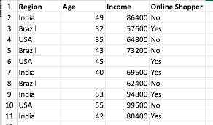
Types: Supervised Learning
Predict response / output / label given input
Input: d-dimensional vector. Features / attributes
Output:
Categorical: Binary, Multi-class, Multi-label
Real valued: Simple regression, multiple regression
Ordinal: Ordinal regression
Ranking: Learning to rank
Structured: Sequence, Tree, Graph
Training set: both inputs and outputs available
Test set: for evaluation; only inputs available
Notes:
Examples:-
Email Spam Detection
Disease Diagnosis
Student Performance Prediction

Slide 21
Types: Unsupervised Learning
Also called Knowledge discovery
No labels available
No clear notion of training
or test
Discover “patterns” e.g. clusters in the data
Density estimation
Evaluation?
Notes:
Examples:
Customer Segmentation
Anomaly Detection
Social Network Analysis

Slide 22
Types: Semi-supervised Learning
Algorithm is trained upon a combination of labeled and unlabeled data
This combination will contain a very small amount of labeled data and a very large amount of unlabeled data.
The basic procedure involved is that first, the programmer will cluster similar data using an unsupervised learning algorithm and then use the existing labeled data to label the rest of the unlabeled data.
Practical applications of Semi-Supervised Learning –
Speech Analysis: Since labeling of audio files is a very intensive task, Semi-Supervised learning is a very natural approach to solve this problem.
Internet Content Classification: Labeling each webpage is an impractical and unfeasible process and thus uses Semi-Supervised learning algorithms. Even the Google search algorithm uses a variant of Semi-Supervised learning to rank the relevance of a webpage for a given query.
Protein Sequence Classification: Since DNA strands are typically very large in size, the rise of Semi-Supervised learning has been imminent in this field.

Slide 23
Types: Reinforcement Learning
A robot vehicle on Mars
Learning to play chess
Direct feedback only at the end
Possibly closer to human learning
Main points in Reinforcement learning –
Input: The input should be an initial state from which the model will start
Output: There are many possible output as there are variety of solution to a particular problem
Training: The training is based upon the input, The model will return an action and the user will decide to reward or punish the model based on its output.
The model continues to learn.
The best solution is decided based on the maximum reward.

Slide 24
Algorithms
Supervised learning
Unsupervised learning
Semi-supervised learning

Slide 25
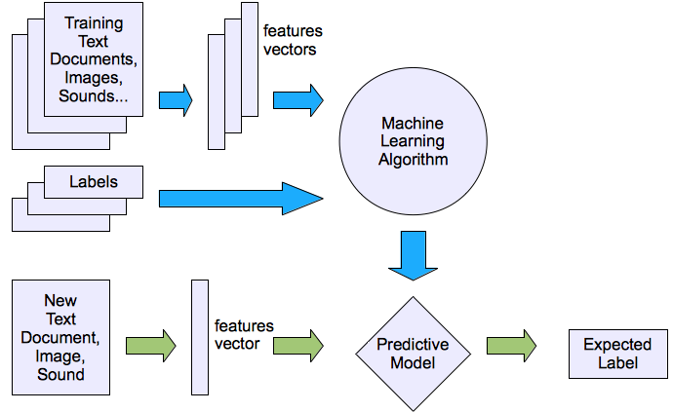
Machine learning structure
Supervised learning

Slide 26
Supervised Learning: Uses
Example: Decision trees tools that create rules
Prediction of future cases: Use the rule to predict the output for future inputs
Knowledge extraction: The rule is easy to understand
Compression: The rule is simpler than the data it explains
Outlier detection: Exceptions that are not covered by the rule, e.g., fraud

Slide 27
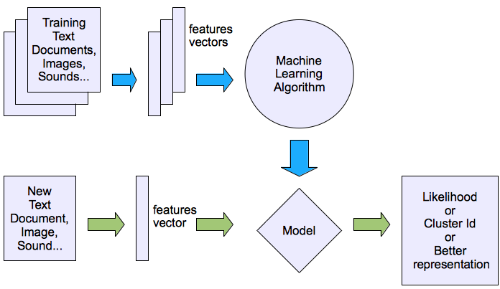
Machine learning structure
Unsupervised learning

Slide 28
Unsupervised Learning
Learning “what normally happens”
No output
Clustering: Grouping similar instances
Other applications: Summarization, Association Analysis
Example applications
Customer segmentation in Customer Relationship Management
Image compression: Color quantization
Bioinformatics: Learning motifs (patterns)

Slide 29
Reinforcement Learning
Topics:
Policies: what actions should an agent take in a particular situation
Utility estimation: how good is a state (→used by policy)
No supervised output but delayed reward
Credit assignment problem (what was responsible for the outcome)
Applications:
Game playing
Robot in a maze
Multiple agents, partial observability, ...

Slide 30
Important concepts
The TF.IDF (Term Frequency times Inverse Document Frequency) a measure of word importance.
Hash functions and their use.
Secondary storage (disk) and its effect on running time of algorithms.
The base e of natural logarithms and identities involving that constant.
Power laws

Slide 31
TF.IDF Measure
Problem of categorizing documents (sequences of words) by their topic
Used to find important words in a document and then characterize documents based on these words
TF-IDF measures the importance of a word based on its frequency in a document and its rarity across the document collection.
TF.IDF - Term Frequency times Inverse Document Frequency
Notes:
TF-IDF (Term Frequency–Inverse Document Frequency) is a statistical measure that tells us how important a word is to a specific document, compared to how commonly it appears across all documents.
TF-IDF measures how unique and meaningful a word is in a document by checking:
How often the word appears in that document (TF), and
How rare or uncommon it is across all documents (IDF).
If a word appears often in one document but is rare in others, it gets a high TF-IDF score, meaning it's important for identifying the topic of that document.
We want words that:
Are not too common across all documents, and
Occur more often in specific documents related to a topic.
These are the words that help identify the topic of a document.

Slide 32
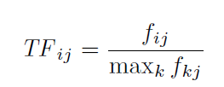
TF (Term Frequency)
Term frequency of term i in document j is fij normalized by dividing it by the maximum number of occurrences of any term (perhaps excluding stop words) in the same document.
Notes:
TFij​: Term Frequency of word i in document j.
fij​: The number of times word i appears in document j.
This formula normalizes how often a word appears in a document — it compares it to the most frequent word in that same document.
So,
If word i is the most frequent word → TF=1
If it appears less frequently → TF is a fraction < 1
Why normalize?
To make sure long documents don’t unfairly favor frequently occurring words.
max_k f_{kj}​: The maximum frequency of any word in document j.

Slide 33

IDF (Inverse Document Frequency)
IDF is a measure of how many documents of the whole collection the word appears.
If there are N documents we need to characterize and we are looking for term i then IDF can be defined as follows:
Notes:
IDFi​: Inverse Document Frequency of word i
N: Total number of documents
ni​: Number of documents that contain word i
This tells us how rare or unique a word is across all documents.
If a word appears in many documents, ni​ is large → IDF is low.
If a word appears in very few documents, ni​ is small → IDF is high.
Helps downweight common words (like "the", "is") and highlight unique words that are more useful for identifying topics.

Slide 34
Problem 1
Suppose our repository consists of 2²⁰ = 1,048,576 documents. Suppose word w appears in 2¹⁰ = 1024 of these documents. Calculate IDF for word w.
Ans: 10

Slide 35
Problem 1
Suppose our repository consists of 2²⁰ = 1,048,576 documents. Suppose word w appears in 2¹⁰ = 1024 of these documents. Calculate IDF for word w.
Ans: 10

Slide 36
Problem 2
Consider a document j in which w appears 20 times, and that is the maximum number of times in which any word appears (perhaps after eliminating stop words). TF_{wj} = 1. Calculate TF.IDF score for w in document j.
Ans:

Slide 37
Problem 2
Consider a document j in which w appears 20 times, and that is the maximum number of times in which any word appears (perhaps after eliminating stop words). TF_{wj} = 1. Calculate TF.IDF score for w in document j.
Ans: 10

Slide 38
Problem 3
For the same problem 2, Calculate TF_{wk} and TF.IDF_{wk} score for w in document k if the number of occurrences of word w is one in document k.
Ans:

Slide 39
Problem 3
For the same problem 2, Calculate TF_{wk} and TF.IDF_{wk} score for w in document k if the number of occurrences of word w is one in document k.
Ans: 1/20, 1/2
Notes:
Consider a document D in which the term "security" appears 15 times. The maximum frequency of any term in the document is 30.
Assume the document belongs to a collection of 10,000 documents, and the term "security" appears in 100 documents.
Calculate TF.IDF for security.

Slide 40
Hash Functions
Hash functions that make hash tables feasible.
For data-mining purposes, hash table takes a different form
Hash function h takes a hash-key value as an argument and produces a bucket number as a result.
Bucket number is an integer, normally in the range 0 to B-1 (B is no. of buckets)
Hash-keys can be of any type
Hash function “randomize” hash-keys
Notes:
h(x) = x mod B

Slide 41
Hash Functions
If hash-keys are drawn randomly from a reasonable population of possible hash-keys, then h will send approximately equal numbers of hash-keys to each of the B buckets.
If the population of possible hash-keys were smaller than B then that population would not be “reasonable.”
Notes:
If your inputs are random and varied, a good hash function will spread them out fairly across all buckets
Eg: Suppose you have:
100 students
10 buckets
A hash function that assigns each student to a bucket
If student names are random and well-distributed, then:
Each bucket will have around 10 students
No single bucket is overloaded or empty
If 50 students but 100 buckets, then equal distribution will not happen.

Slide 42
Hash Functions
If hash-keys are strings, convert each character to its ASCII or Unicode equivalent, which can be interpreted as a small integer.
Sum the integers before dividing by B. Incase B is smaller than the typical sum of character codes for the population of strings, the distribution into buckets will be relatively uniform.
If B is larger, then we can partition the characters of a string into groups of several characters each. Treat the concatenation of the codes for the characters of a group as a single integer. Sum the integers associated with all the groups of a string, and divide by B as before.
Notes:
3.
When you’re hashing a string (like a name or word), the idea is to:
Convert it into numbers
Then use those numbers to get a bucket number using a hash function like mod B.
Eg:- h("CAT")=216mod10=6 (67+65+84=216)
If B is large (say a billion), just adding up each character’s code (like A=65, B=66, etc.) may not give you enough variation. So we do something smarter:
example:
Let’s say your string is: "ABCD" And you want to hash it into B = 1,000,000
Step 1: Convert characters to ASCII codes
A = 65
B = 66
C = 67
D = 68
Step 2: Group characters (say, in groups of 2)
Group 1 = A and B Group 2 = C and D
Step 3: Concatenate codes in each group
Group 1 → "65" + "66" = "6566" → as a number → 6566
Group 2 → "67" + "68" = "6768" → as a number → 6768
Step 4: Add the group values
6566 + 6768 = 13,334
Step 5: Do mod B
13,334mod 1,000,000 =13,334
So the final bucket number is 13,334
Why do we do this?
When B is huge, small numbers from simple character sums (like 65 + 66 = 131) are too small. → So grouping characters and treating them as bigger numbers gives better spread across big bucket ranges.

Slide 43
Hash Functions
For more complex data types, we can extend the idea used for converting strings to integers, recursively.
For a type that is a record, each of whose components has its own type, recursively convert the value of each component to an integer, using the algorithm appropriate for the type of that component. Sum the integers for the components, and convert the integer sum to buckets by dividing by B.
For a type that is an array, set, or bag of elements of some one type, convert the values of the elements’ type to integers, sum the integers, and divide by B.
Notes:
A record is a composite data type with multiple fields of possibly different types (like a struct in C or a dictionary in Python).
Example: Case 1: Suppose you have a record like this:
json
{ "name": "Tom", "age": 25, "zip": 90210 }
Step-by-step:
Let's assume:
"Tom" → convert string to integer: e.g., use ASCII: T(84)+o(111)+m(109) = 304
25 is already an integer
90210 is already an integer
Now sum the components: 304 (name) + 25 (age) + 90210 (zip) = 90539
If number of buckets B = 1000, then:
bucket = 90539 % 1000 = 539
So this record would be placed in bucket 539.
Case 2: Array / Set / Bag (List of Values of the Same Type)
An array, set, or bag contains multiple values of the same type.
Example: Array of zip codes: [12345, 23456, 34567]
Step-by-step:
Just add the integers: 12345 + 23456 + 34567 = 70368
Divide by number of buckets, say B = 1000:
bucket = 70368 % 1000 = 368

Slide 44
Indexes
Data structure that makes it efficient to retrieve objects given the value of one or more elements of those objects.
most common situation is one where the objects are records, and the index is on one of the fields of that record.
Given a value v for that field, the index lets us retrieve all the records with value v in that field, without having to retrieve all the records in the file.
Notes:
What is an Index?
An index is like a shortcut that helps you find data quickly without searching through everything.
Example:
Imagine you have a phone book with thousands of names. If you want to find "Sally Jones", you don't check every page — you use the index to jump to the correct page. That’s what an index does in a computer too.
Records and Fields
A record is a group of related information — like:
(Name, Address, Phone) ("Sally Jones", "Maple St", "800-555-1212")
If you have thousands of these records, and you want to search by phone number, creating an index on the phone field helps you find matches much faster.

Slide 45
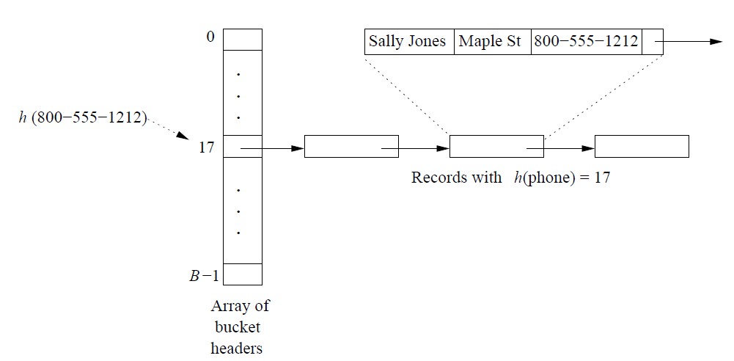
Indexes
A hash table is one simple way to build an index.
The field or fields on which the index is based form the hash-key for a hash function.
Notes:
Using a Hash Table for Indexing
Step-by-step:
Choose a hash field (e.g., phone number).
Apply a hash function to it — this converts the phone number into a bucket number.
Store the full record in that bucket.
So instead of checking all records, you go straight to one bucket!
Example:
Let’s say you have a phone number:
800-555-1212
A hash function like h(phone) converts it to a number — say 17.
So, this record is placed in bucket 17.
Bucket 17 might contain other records whose phone numbers also hash to 17.
What is a Bucket?
Think of buckets like boxes that group records.
Each bucket can hold one or more records.
Usually stored as a linked list (a chain of records).
So, instead of searching all records, you:
Hash the phone number.
Jump directly to the right bucket (like bucket 17).
Search only inside that small bucket.
Why is this efficient?
If you have:
1000 records
1000 buckets
Then on average, each bucket has just 1 record → Very fast to search!
Even with 2–3 records per bucket, it’s way faster than checking all 1000.

Slide 46
Secondary Storage
Knowledge of time taken to perform computations when the data is initially on disk is important
Disks are organized into blocks, which are the minimum units that the operating system uses to move data between main memory and disk.
The Windows operating system uses blocks of 64K bytes. It takes approximately ten milliseconds to access (move the disk head to the track of the block and wait for the block to rotate under the head) and read a disk block.
Notes:
1. Disk access is slow: Reading a block (e.g., 64KB in Windows) from disk takes around 10 milliseconds, which is about 100,000 times slower than accessing main memory.
2. Computation time is negligible compared to the disk access time, even simple tasks like scanning all bytes in a block are dominated by the time it takes to load that block from disk.
3. Optimizing data layout: If related data (e.g., hash bucket records) is placed on the same cylinder (same radial distance on disk), we can read multiple blocks faster, much less than 10 ms per block, by avoiding head movement.
4. Transfer speed limit: Even with optimized layout, disk-to-memory speed is capped at 100 million bytes/second.
5. Key insight: To speed up computations on disk-based data, reduce disk accesses and organize related data together.

Slide 47
Secondary Storage
This access time is at least five orders of magnitude (a factor of 10⁵) slower than the time taken to read a word from main memory.
If we want to do something simple to every byte of a disk block, e.g., treat the block as a bucket of a hash table and search for a particular value of the hash-key among all the records in that bucket, then the time taken to move the block from disk to main memory will be far larger than the time taken to do the computation.
By organizing our data so that related data is on a single cylinder (the collection of blocks reachable at a fixed radius from the center of the disk, and therefore accessible without moving the disk head), we can read all the blocks on the cylinder into main memory in considerably less than 10 milliseconds per block. You can assume that a disk cannot transfer data to main memory at more than a hundred million bytes per second, no matter how that data is organized.

Slide 48






Base of Natural Logarithms
Constant e has special properties.
You get e, for when x tends to infinity
We can approximate complex expressions using the above expression
Consider for approximation
Rewrite as:
Substitute: a=1/x and 1/a=x.
Final :
Notes:
e=_{x→∞}lim​(1+1/x​)^{x}

Slide 49
Base of Natural Logarithms
Taylor series
When x is large, the above series converges slowly, although it does converge because n! grows faster than x^{n} for any constant x. However, when x is small, either positive or negative, the series converges rapidly, and only a few terms are necessary to get a good approximation.
Notes:
Use few terms if x is small → fast and accurate approximation.
Need many terms if x is large → slower convergence.
This is a tradeoff between accuracy and computation when using series approximations in algorithms.

Slide 50

Power Laws
One important law where so many applications are there.
Power law is a linear relationship between the logarithms of the variables.
General form:
Notes:
A power law describes a relationship between two quantities where one is proportional to a power of the other:
y=c⋅xª ,
Taking the logarithm of both sides:
logy=logc+alogx This is a linear equation in log-log space, just like:
log y = b + a logx

Slide 51
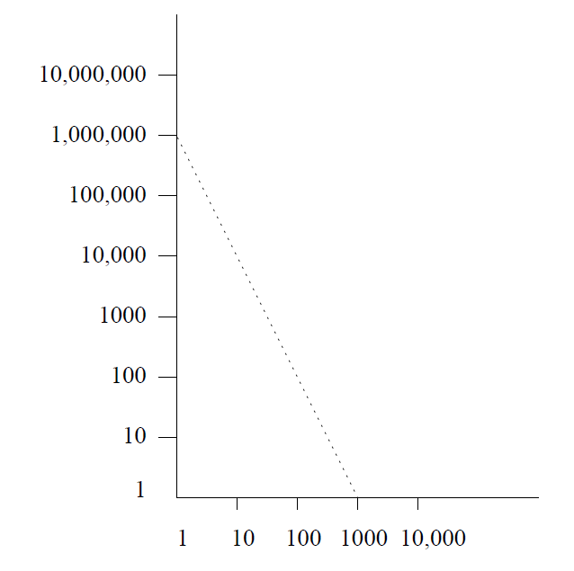

Power Laws
Ranking of books based on their selling figures
Notes:
If you plot log(y) vs log(x), and the result is a straight line, then the data follows a power law.
The plot shows a straight line with a negative slope.
This suggests a power-law decay, where large values become rare quickly.
Example in context: This type of curve appears in the ranking of books by popularity:
A few books sell millions of copies.
Most sell very few.
This is Zipf’s Law, a special case of power law.
You’re given:
log10​y=6−2log10​x This can be rewritten using exponent rules:
y=106⋅x−2
As x increases, y decreases rapidly.
The slope -2 indicates a steep fall-off (typical in rankings, wealth distributions, etc.)
Real-World Applications of Power Laws
Book Sales: A few books dominate sales.
Internet Traffic: A few websites get most traffic.
Wealth Distribution: A small percent hold majority of wealth.
Earthquake Magnitudes: Frequency of large ones is very low.
Social Networks: A few users have massive followers; most have few.

Slide 52
Other real-world applications
Node Degrees in the Web Graph: Order all pages by the number of inlinks to that page.
Sales of Products: Order products, say books at Amazon.com, by their sales over the past year.
Sizes of Web Sites: Count the number of pages at Web sites, and order sites by the number of their pages.
Zipf ’s Law: This power law originally referred to the frequency of words in a collection of documents.

Slide 53
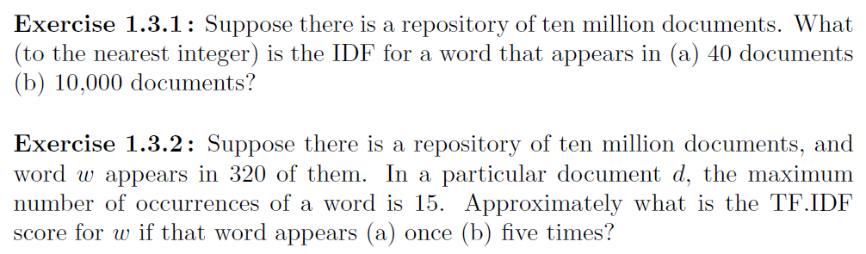
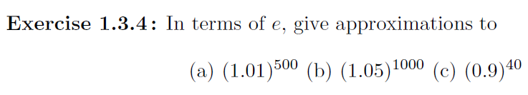
Exercises
Notes:
Use the formula and solve for 1 and 2
1.3.4:
a) e^5, b) e^50, c) e^-4

Slide 54
THANK YOU

